Slide 1
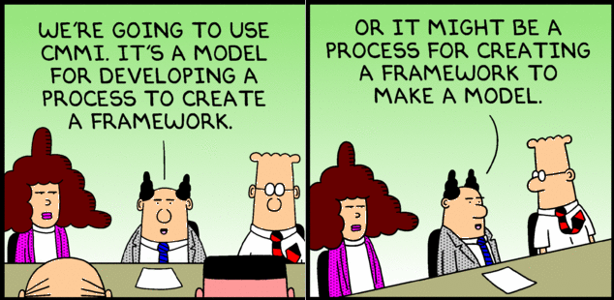
System Diagrams
A Visual representation of the system

Slide 2
Model
  Architecture is an abstraction
    Highlight the important aspects
    Hide details
    e.g. subway map
      Does not show building & streets
      Distorts geography, positioning, and distance
      Only shows stations & lines → easy to understand important things
        Main goal: navigation – getting from point A to point B
  Architecture is expressed as a model
  Model - description without details
    Details are systematically removed for a purpose
    Intentional simplification to understand an analyze complex problems
https://www.cl.cam.ac.uk/teaching/1112/SWDesign/softwaredesign01.pdf

Slide 3
Model
  The most important engineering tool
    You cannot consume every detail
      Miller's Law 7±2
      => multiple levels of abstractions
    Allows for the …
      Understanding and analysis of large & complex problems
      Communication of the architecture
      Sharing of knowledge
      Investigation of incidents without reading the code base
A model can be:
  Picture (static)
    Visual perception times faster than text (60k times + better retention)
  Visual flow (sequence, flowchart, relationship)
    Cannot express time in other way → static pictures
  Approximating formula for a metric of the system
    Dependency between something & performance / complexity / usability
    e.g. track every car VS traffic flow equation
    e.g. Big O – no need for algo details (need nlogn)
  Can describe different views of the system
https://www.cl.cam.ac.uk/teaching/1112/SWDesign/softwaredesign01.pdf

Slide 4
Views and Models
Complex systems cannot be understood via 1 perspective
  Different stakeholders have different perspectives
    e.g., airport
      security – passenger flow & checkpoints
      “baggage department” – baggage flow
      air control – air traffic
      maintenance – energy consumption
      All of these perspectives cannot put into 1 consumable model
  Model – abstraction / blueprint of a system
    e.g. patients, doctors, nurses, appointment system - what & connections
  View – representation of a model from some perspective
    e.g. how a patient books an appointment
  A model is the complete, high-level picture; a view is a deliberate slice of the model for a specific audience or question.

Slide 5
Views and Models – User Model
How a user interacts with the software
Flowcharts; process maps; …
e.g. ATM money withdrawal
  Insert card
  Enter PIN
  Request amount
  Dispense cash
  Receipt
  What’s missing?
    Returning the card
  Incorrect models result in dysfunctional systems

Slide 6
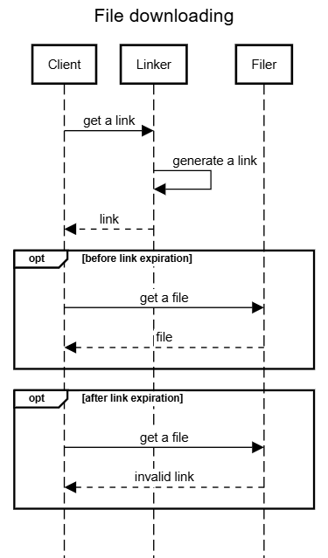
Views and Models – Interface View
How different APIs are used
Sequence diagrams
e.g. file downloading
  Call link generating endpoint
  Receive a time-limited link
  Use the link to obtain a file
How to integrate
  What endpoints to call and in what order
  What data is exchanged at each step
  How errors and edge cases are handled

Slide 7
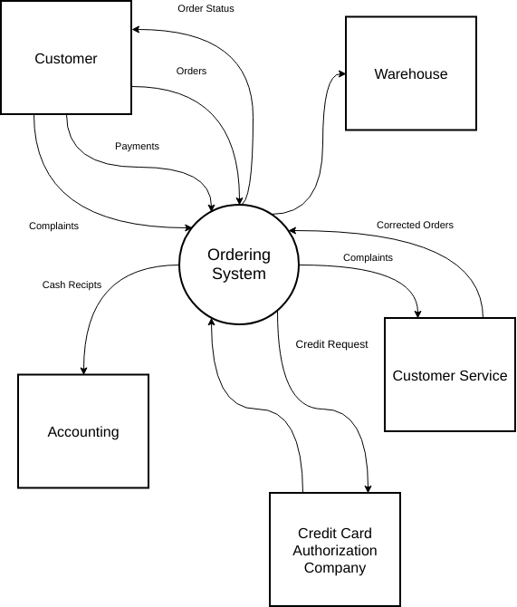
Views and Models – System View
How components interact with each other
Main components; connections; operations; …
Component diagrams, architecture diagrams,..
e.g. ordering system
  Customer — places orders & payments
  Ordering System — central hub
  Warehouse — fulfillment & corrected orders
  Customer Service — handles complaints
  Accounting & Credit Card Authorization — financial flows
Map of a city

Slide 8
Views and Models – Performance Model
Calculate the performance of an operation within certain scenarios
  Spreadsheets; formulas;..
  e.g., percentage of 504 (time out) customers get when N requests
  e.g., what hardware is needed for N parallel customers
  e.g., how many parallel request can withhold
  e.g., algorithm complexity is different – consequences?
  very system specific
Modeling Netflix
  User model – browsing & playing movies
  Interface view – API call between FE & BE
  System view – microservices & CDN
  Performance model – streaming quality when 1M viewers

Slide 9
Types of Views
  System Diagram – Abstract description of the system whose requirements are being modeled
    What is there & how connected
    High-level – major subsystems
    Communicate to stakeholders
  Module View – Structure of the code base
    Packages, classes, layers, modules
    Used by devs & for onboarding
  Component and Connector Views – What exists & connected in runtime
    e.g. REST calls, event buses, data streams
    NOT sequence of events
    Runtime as a static picture
  Allocation Views – Software to environment mapping
    e.g. microservice → docker → k8s → set of nodes → AWS
    e.g. endpoint handler → Lambda function → AWS
    e.g. mobile app → phone / smart tv / browser

Slide 10
Types of Views
  Quality Views – Extracted relevant pieces of structural views and packaging them together
    e.g. security view – how auth handled & how data is protected
    e.g. performance view – data flows, caching, bottlenecks
    e.g. availability view – redundancy, failover, clusters
  Behavior Views – Interactions between components when the system is a specific state
    Sequence of events for a specific case
    Sequence diagrams
  Can create custom views
  depends on a system / people / situation / needs
  e.g. asked for a PII (Personally Identifiable Information) data flow specifically

Slide 11
Which Views? The Ones You Need!
You don’t need every possible / listed view
  They are tools
    Use the appropriate view to solve problems & communicate
    Not just because “it must be done”
      e.g. plumbing diagram for a tree house
  Different views support different goals and uses
  Depends on stakeholders / needs / documentation use
    Onboarding → module view
    DevOps → allocation view
    Executives → system view
  Trade-off
    Benefit – clear communications, less errors, better analysis
    Cost – efforts & time to create & maintain
At a minimum, you should have at least one module view and one component and connector view

Slide 12
System Diagram
  Abstract Description of the system
  High-level abstraction / model
  Not a full C & C view — a stakeholder-accessible overview
Components of a System Diagram:
Boundaries of the system
  What is within & outside
  e.g. credit bureau is outside (still be shown)
  Avoid scope creep
Inputs to and outputs from the system
  Inputs – requests, user actions, data streams, events
    e.g., PIN entry, withdrawal request
  Outputs – produced value / results
    e.g., cash, receipt, account balance information
Subsystems of the system
  Major parts
  e.g. video processing, ordering, payment
Interfaces between the subsystems
  How subsystems communicate
    e.g. ordering interacts with payment, triggers shipping
Describes high-level design decisions

Slide 13
Why Create a System Diagram?
  Stakeholders – engineers, managers, QA, customer, etc
    Very different background, interests, and vocabularies
    SD - simple visual language, simple entities
  SD use cases:
    Explain requirements (ties to the architecture) to stakeholders
      e.g. “support 3rd-party payment providers”
        Diagram: mobile app → payment gateway → bank APIs
  High-level design discussion among engineers / architects
      Helpful to compare multiple competing solutions
      Hard to explain in words, but easy to perceive visually
      Avoids misunderstandings
  Document the system for implementation
    Guidelines / reference / documentation
    How the system should be implemented
  Show the architecture in any other case
    e.g. investors want to understand / audit
The SD needs to be maintained throughout the lifecycle of the system!

Slide 14
System Diagram Focus and Content
System Diagrams are variable in their view of the system
A system diagram can show / emphasize
  Components
    Subsystems & how they are grouped
    Q: What are the main parts?
      e.g. map subsystems on departments
  Interactions
    Connections among subsystems
    Q: How do parts communicate?
  Boundaries
  …
Choose the type of information that you want to convey and the questions you want to answer
  Big blocks
    Very high level for C-management
  APIs
    Integration points for developers
  Physical assets
  Data or communications
    Information flow
  …
Then select HOW you will show it
Components & Interactions tend to be the most common

Slide 15
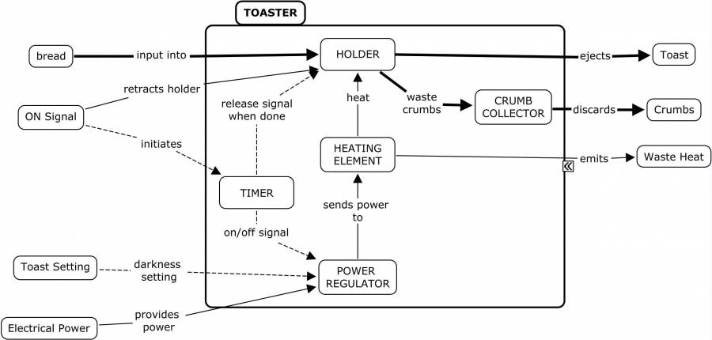
Toaster System Diagram
Inputs
Outputs
System
Where’s the WIFI connection?
https://deseng.ryerson.ca/dokuwiki/_detail/design:toasterarchitecture.jpg?id=design%3Asystem_diagram
Notes:
What is missing?

Slide 16
Onboarding System
Legacy Workflow
Form Submission Service
Step 1
Call OBC
Step 2
…
…
Step N
Call Legacy Service
Inserting a new service into an existing legacy workflow
Resubmit Service
Legacy Message Service
Onboarding Center
Legacy Service
OBC REST Service
OBC Backend Processor
Legacy Task Code
OBC Processor
Status Monitor
Core Advanced DB
Oracle
OBC DB
SQL Server
Email to Admin on Failure
Email to Salesperson
Success | Failure
Notes:
Early prototype of the system built to illustrate that a new service could be interposed in the legacy workflow and enrich the content flowing into the Legacy System (Green box).

Slide 17
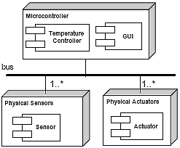
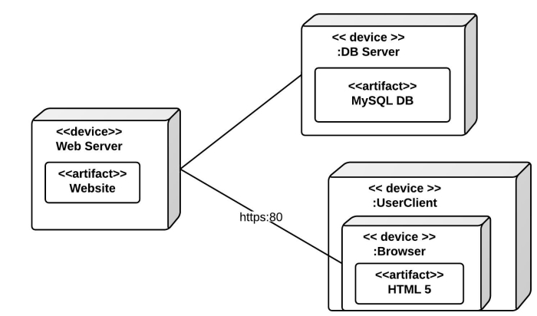
Allocation View Examples
Software elements (artifacts) mapped to environmental elements (devices)
Web Application
Embedded Controller

Slide 18
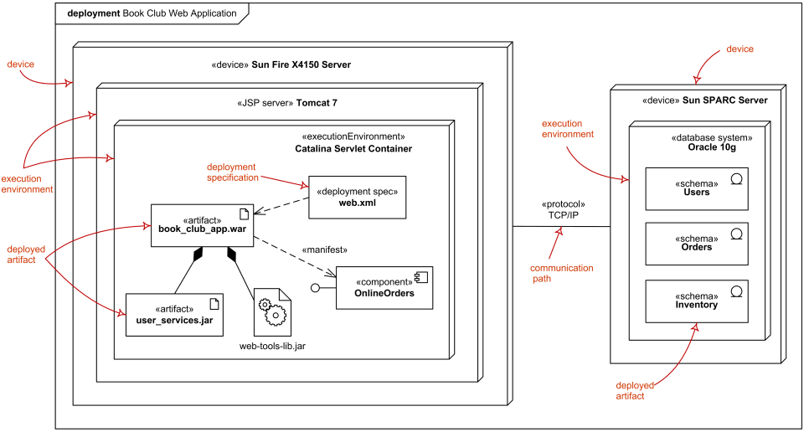
Allocation View
UML Deployment Diagram Example
(One notation for
Allocation Views)

Slide 19
Usage of Allocation Views
Without:
  What software exists
  Not where it runs
  Not how it is delivered
Helps to understand
  What hardware and software is needed
    Servers, cloud instances
  Where should be placed
    Cloud vs on-premise
    ML model – local (latency) vs cloud GPU (performance) vs availability vs security vs etc
  Defines responsibility and maintenance distribution across teams
  How to setup CI/CD
    Builds, integration testing, version control, etc
    Local service vs k8s in cloud – different processes

Slide 20
Usage of Allocation Views
Elements
  Software element
    Logical modules – processes, services, packages
  Environmental element
    Execution - hardware, runtime operation
    Development - file structure, deployment, development organization
    Properties of an environment
      e.g., network bandwidth, CPU performance, etc
        Bandwidth defines video streaming quality
Relationships
  Software element (logical) is mapped (allocated to) an environmental element (physical)
  Static or dynamic
    Static – always the same environment element
    Dynamic – vary (e.g., autoscaling – new containers / nodes)

Slide 21
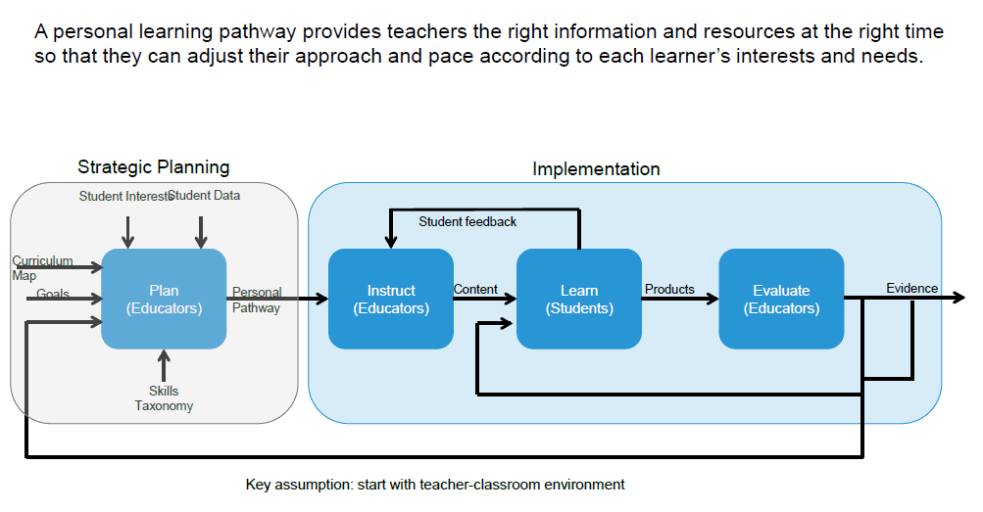
Personal Learning Pathways: Systems View
Notes:
A system designed at PARC for Personalized Learning. Used to discuss the system with school administrators, teachers and parents

Slide 22
Unit of study as a context for prototyping
Student Performance
Learn
(Students)
Feedback for instruction & planning
Student Profile
Instruct
(Teacher)
Practice
Plan
(Teacher)
Paths
Evaluate
(Teacher)
Evidence
Demo
Content, Curriculum map
Student Profile
Alerts
Goals and Interests
SIS
Unpack concepts
Sequence
Scaffold
Model
Assign
Score
Monitor
Adjust
Communicate
Collaborate
Teach interventions
Mastery
Growth
Portfolio
  Exemplar
  Parent/teacher
  APPR
  Issue tracking
Practice (assignments, check-ins, formative assess)
Demonstrate (summative, benchmark)
Collaborate (teachers, peers)
Reflect on student performance
Student Performance
Pre-assessment
ELA summary
Writing samples
Paths
Mastery visualization
Student grouping
Key messages
Providing teachers a dynamic, holistic view of each student facilitates personalization day-to-day.
Easy and timely access to the desired information is a key challenge.
Understanding what teachers do with this information guides future development.
22
Notes:
A more detailed view that layers in where various functionality exists in the system. The circled items are were the development team was initially focused.

Slide 23
Metrics & Performance:
Allocation to the System
Database usage examples:
Average query size: 2KB
  Queries/Day: 20,000
  Transactional load: Queries/Day x Query size = 40 MB/day
Retail
  Size of item: 1KB
  # of items: 5,000
  Size of DB Storage: 5,000 x 1,000 = 5MB
  What if will grow to 5,000,000 items?
  What if the item size is 1 MB?
Performance:
  Image recognition system
    10 seconds per operation
    10,000 request per minute
    100,000 seconds CPU time required per minute**
Helps to understand required HW characteristics to handle the workload
The catch: this is average load – you need to plan for peak load
Make sure the math is mathing
** Will that work?

